Slide 1
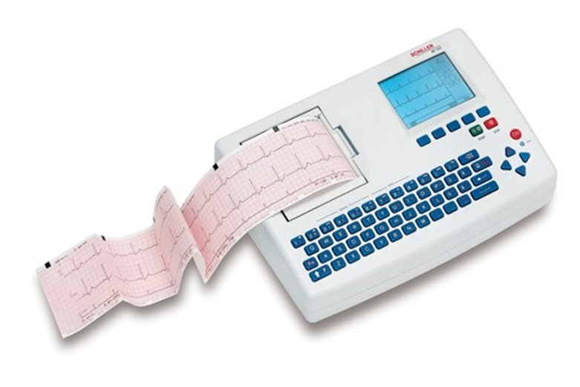
ECG Recorder and Monitor
principles of operation
  function
  use
construction
  components
  system diagram
  inputs/outputs
troubleshooting
  identifying common faults
  replacing components
  rectifying faults
safety considerations
  user and patient safety
  electrical safety
performance monitoring
  calibration
  quality assurance and control
18.1.3 ECG recorder and monitor
Unit C 18.1 Maintaining cardiovascular and monitoring equipment
Module 279 19 C Medical Instrumentation II
©
dr. Chris R. Mol, BME, NORTEC, 2017

Slide 2
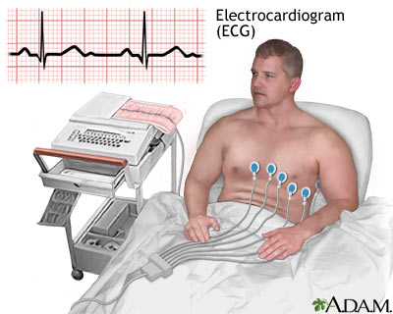
Function
Electrocardiographs detect the electrical signals associated with cardiac activity and produce an ECG, a graphic record of the voltage versus time.
They are used to:
measure the rate and rhythm of the heart,
measure the size and position of the heart chambers,
detect the presence of any damage to the heart's muscle cells or conduction system,
measure the effects of cardiac drugs,
measure the function of implanted pacemakers.
All this is very important for the diagnosis and treatment of some types of heart disease.
©
ECG Recorder and Monitor
dr. Chris R. Mol, BME, NORTEC, 2017

Slide 3
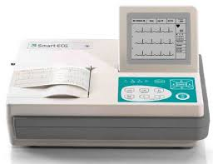
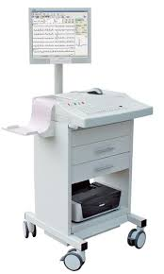
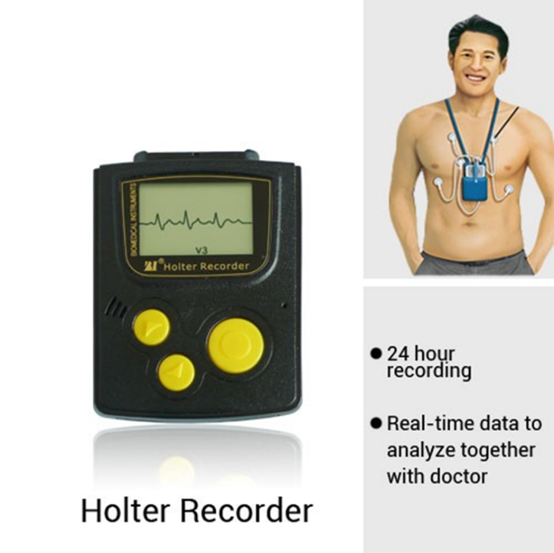
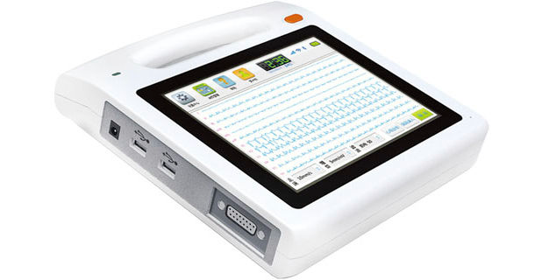
Product specifications
Approx. dimensions (mm): 120 x 400 x 350
Approx. weight (kg): 6
Consumables: Batteries, cables, electrodes
Price range (USD): 975 - 6,000
Typical product life time (years): 10
Shelf life (consumables): 1-2 years for disposable electrodes/sensors
desktop ECG recorder
cart based
ECG recorder
Portable ECG recorder
©
ECG Recorder and Monitor
dr. Chris R. Mol, BME, NORTEC, 2017

Slide 4
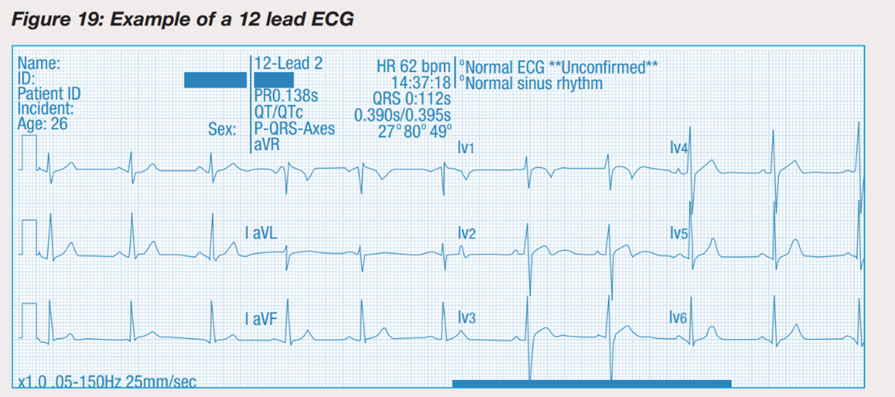
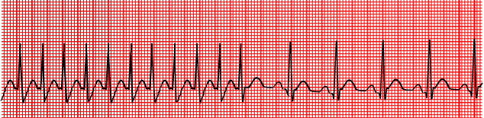
Operating steps
After the electrodes are attached to the patient, the user selects on the ECG system:
  automatic or manual lead switching
  signal sensitivity
  frequency response range
  chart speed
In some units, the operator can choose the lead groupings, their sequence, and the recording duration for each group.
In standard 12-lead ECG, signals are recorded for 2.5 seconds and combined on one paper / screen
For a rhythm strip, one lead (usually lead II) is recorded for 12 seconds.
©
ECG Recorder and Monitor
dr. Chris R. Mol, BME, NORTEC, 2017

Slide 5
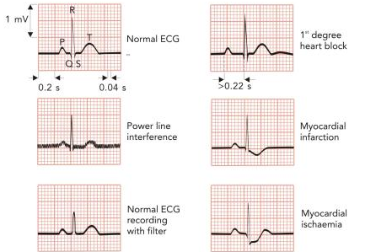
Use
the ECG can be influenced by technical issues such as power line interference, poor connections and ECG filtering
Of course, the ECG is also influenced by heart condition and disease
For a BMET, it is important to recognize whether an ECG is disturbed by system problems or by cardiac abnormalities
©
ECG Recorder and Monitor
dr. Chris R. Mol, BME, NORTEC, 2017

Slide 6
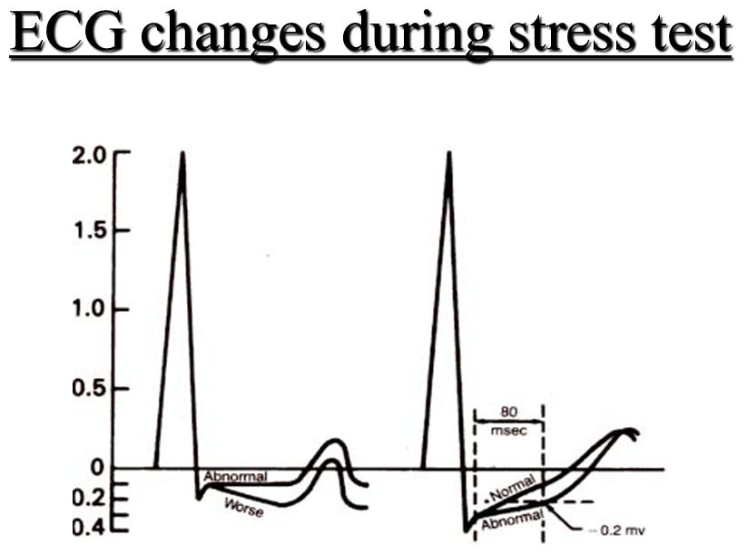
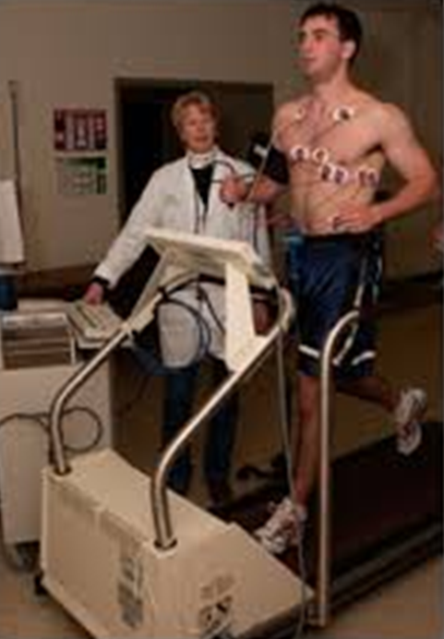
Use
ECG recording can be made at rest and during exercise (stress test).
This is useful because some heart abnormalities only show up during exercise when the heart has to work harder and faster.
ECG recorders may also be used for monitoring, e.g. during surgery or intensive care.
In this case, the ECG recorder is usually a part of a physiological monitor (see later).
©
ECG Recorder and Monitor
dr. Chris R. Mol, BME, NORTEC, 2017

Slide 7
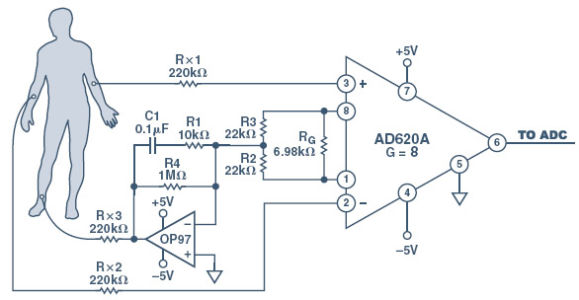
System Diagram
An ECG units consist of the ECG unit, electrodes, and cables.
The core of the ECG system is the Amplifier.
An ECG amplifier has high Input Impedance ( >100 MΩ) and a high gain (1000x), amplifying the ECG signal from milli-Volts >> Volts.
Its Frequency Range is 0.05–150 Hz.
©
ECG Recorder and Monitor
dr. Chris R. Mol, BME, NORTEC, 2017

Slide 8
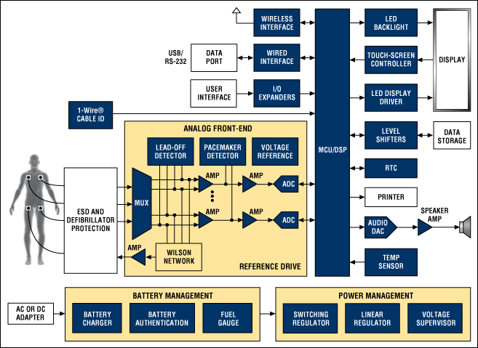
System Diagram
Blocks in the diagram are often implemented on different Printed Circuit Boards in the system.
©
ECG Recorder and Monitor
dr. Chris R. Mol, BME, NORTEC, 2017

Slide 9

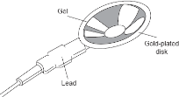
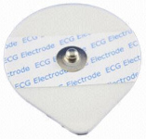
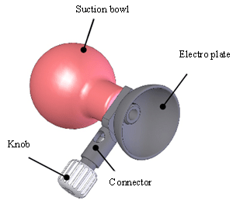
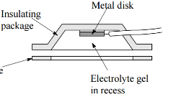
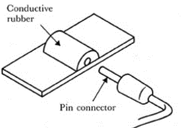
Components: Electrode Types
Metal Plate Electrodes
  large surface electrodes for ECG
  metal disk electrodes for EMG, EEG
    stainless steel with coating of platinum or gold
  Disposable foam pad (cheap!) for ECG
application to limb
application with surgical tape
Suction Electrodes
  no adhesives. For ECG (short term only)
Floating Electrodes
  recessed metal disk (swimming in gel)
  less sensitive to motion
Flexible Electrodes (may fit better)
  polymer or nylon with silver deposits
  or carbon filled silicon rubber as thin film
©
Transducers
dr. Chris R. Mol, BME, NORTEC, 2017

Slide 10
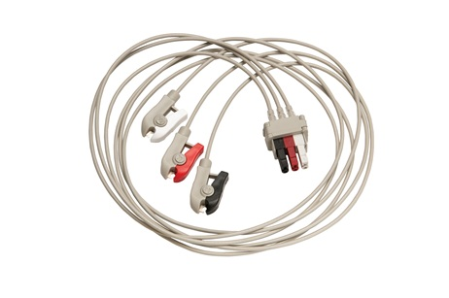
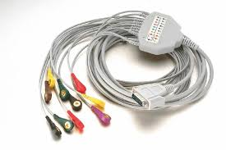
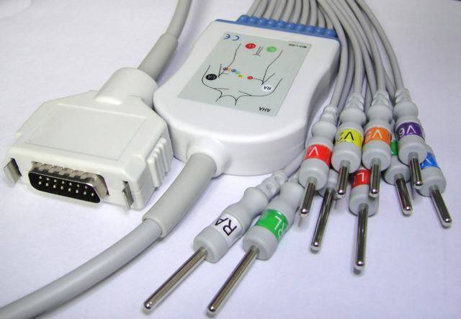
Cables
Cables from different manufacturers differ in connections
both on system side and on electrode side ….
©
ECG Recorder and Monitor
dr. Chris R. Mol, BME, NORTEC, 2017

Slide 11
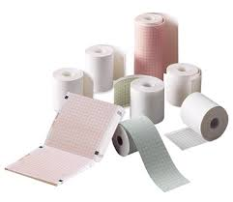
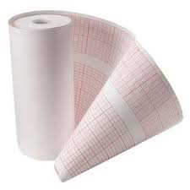
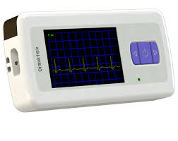
Output
ECG paper: different sizes dependent on brand and model….
and different screens for different applications (e.g. ambulance)
©
ECG Recorder and Monitor
dr. Chris R. Mol, BME, NORTEC, 2017

Slide 12
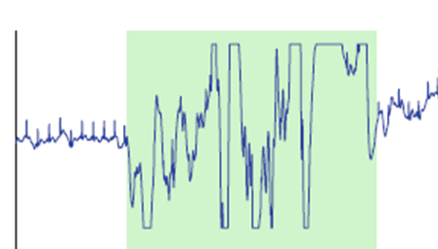
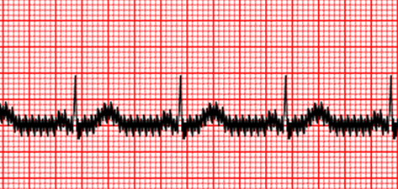
Troubleshooting: User error, electrode placement
The most common problem with ECG systems is user error. Modern ECG recorders have many buttons and controls and can be quite confusing. Therefore, if the machine turns on, the first thing to suspect is user error.
poor electrode cleaning
poor electrode placement
poor skin preparation
can be the cause of a poor, noisy ECG signal and can result in a BMET call
A saturated ECG is almost always caused by problems with electrodes or lead wires (or loose connections.),
an ECG distorted by AC interference = power line noise (50 Hz). You can verify this by removing the machine room to see if this solves the problem.
©
ECG Recorder and Monitor
dr. Chris R. Mol, BME, NORTEC, 2017

Slide 13
Troubleshooting: User error, electrode placement
Attention points with electrode placement:
  electrodes should not be placed on scar tissue
  electrodes should not be placed over a lot of body hair
  electrodes placed closer than 2 inches from each may cause signal problems
  if more than one device requires that electrodes be placed on the patient they may interfere with each other.
Switching to different leads, repositioning electrodes and shaving the skin may resolve these problems
©
ECG Recorder and Monitor
dr. Chris R. Mol, BME, NORTEC, 2017

Slide 14
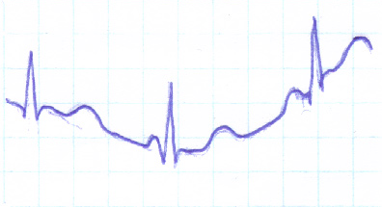
Troubleshooting: More user error
  patient movement during recording
  the patient may be cold or nervous and shivering. If so, muscle tremors could be causing the interference.
  the patient or nurse may be touching any metal or nearby wall during recording.
  system settings:
    the device must be set correctly for the local power line frequency.
    ‘gain’ (amplification) settings must not be too high (saturation) or too low (no signal)
      wrong gain setting may also cause incorrect display on the heart rate meter, if this does not have an automatic gain, as in older machines.
Wandering baseline is noticed by the technician as the line between cardiac cycles bounces around or jumps. This is most often caused by attempting to use a monitor in the wrong (diagnostic) mode or by electrode placement or electrode quality.
©
ECG Recorder and Monitor
dr. Chris R. Mol, BME, NORTEC, 2017

Slide 15
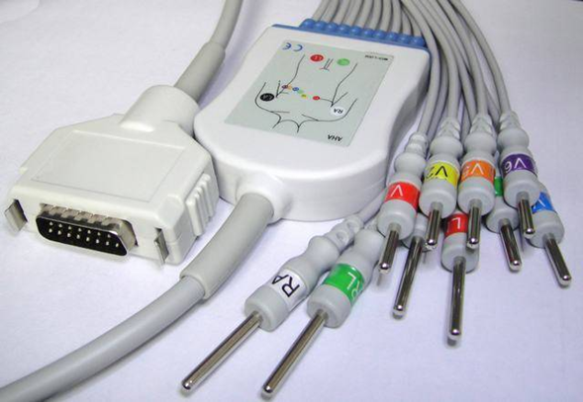
Troubleshooting: Technical problems
Technically, the weakest link in an ECG system are the lead wires. The patient cable should last for many years. However, abusive use can lead to wire breakage.
Before rejecting a lead wire, try a different wire from another machine to confirm that this is the cause. Lead wires often look to be in poor condition because of tape residue on the cable. This residue can be removed using alcohol or other solvents.
If the lead wire is at fault, replacement is the preferred option. However, lead wires can be repaired in some cases.
To find the faulty wire, for each position on the patient selector switch, wiggle the patient cord at its end, in the middle where the leads fan out, and at the machine plug end. A break will be evidenced by a violent deflection on the display. If the break is in the last, typically quite thin, part of the lead, this can be cut and soldered in the standard fashion, as the last dozen inches are typically unshielded wire. If there is a shield, be sure to reconnect it as well.
©
ECG Recorder and Monitor
dr. Chris R. Mol, BME, NORTEC, 2017

Slide 16
Troubleshooting: remaining problems
When no trace shows up at all, the most typical cause is user error.
  There may be brightness settings, or an off position.
  Power supply problems should also be suspected.
Bad electrodes and lead wires do not typically cause the trace to disappear.
If the trace does not appear, and the device is a printing-ECG system, you may have problems with the printer. With the heated stylus, the pressure of the stylus on the paper can affect the width of the trace and its frequency response. If too much heat is used the trace will also be widened. If too little is applied, then no trace will appear.
And, if all the above has been checked, you can suspect an electrical or electronic problem (PCB’s!) inside the unit.
©
ECG Recorder and Monitor
dr. Chris R. Mol, BME, NORTEC, 2017

Slide 17
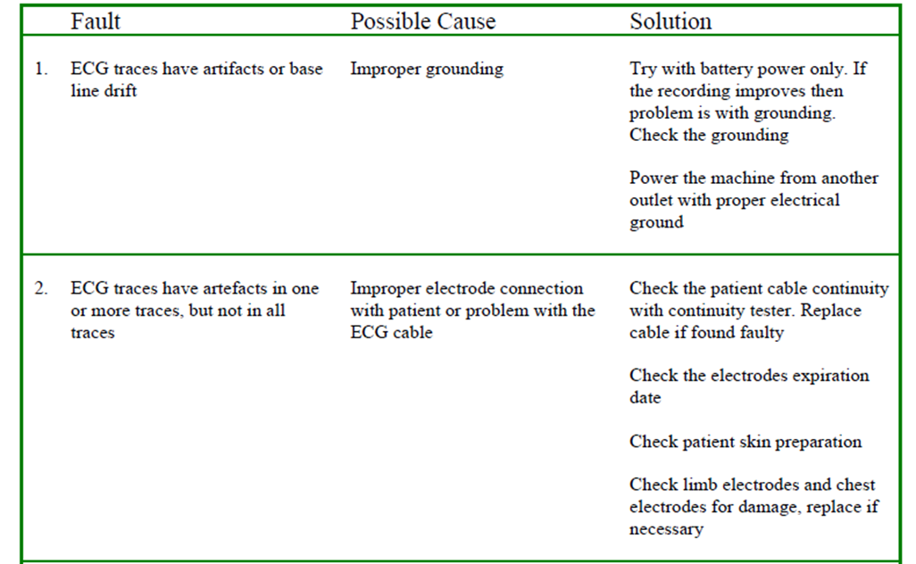
Troubleshooting
©
ECG Recorder and Monitor
dr. Chris R. Mol, BME, NORTEC, 2017

Slide 18
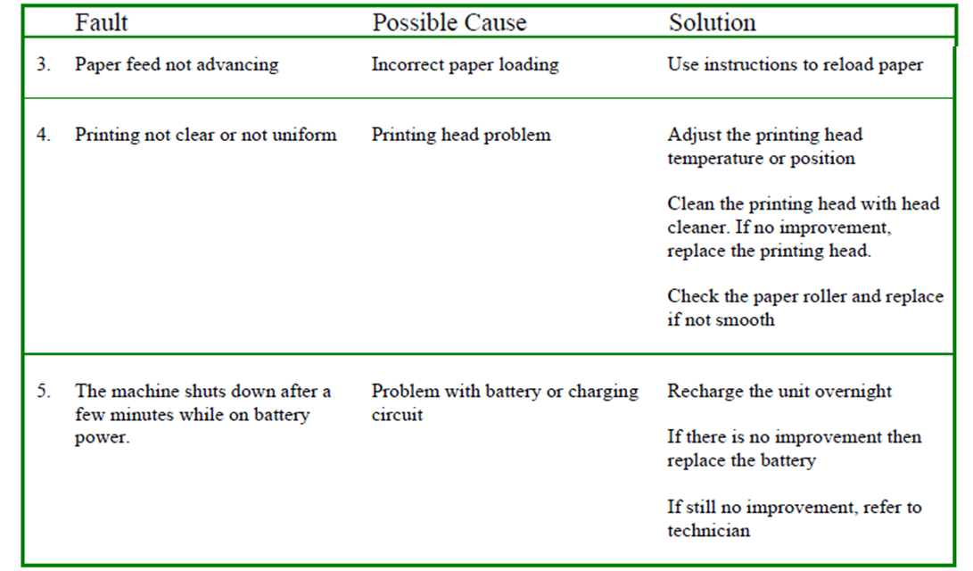
Troubleshooting
©
ECG Recorder and Monitor
dr. Chris R. Mol, BME, NORTEC, 2017

Slide 19
Troubleshooting: Electric Safety
Because electrocardiographs have electrical safety standards that are well established and adhered to by all major manufacturers, few safety problems are associated with their use.
Still, electric safety tests, incl. earth leakage currents and circuit isolation, are an important and standard part of all preventive maintenance !
©
ECG Recorder and Monitor
dr. Chris R. Mol, BME, NORTEC, 2017

Slide 20
Performance monitoring
For most monitoring ECG’s, it is sufficient to simply connect the ECG to yourself and record an accurate ECG and heart rate. If the heart rate matches your own (as measured with a watch while feeling the artery in your neck), and the ECG looks like a normal ECG, then the device is probably working.
You should check the heart rate alarms to make sure that they sound when they are set either
  lower than your own heart rate (upper rate alarm) or
  higher than your own heart rate (lower rate alarm).
©
ECG Recorder and Monitor
dr. Chris R. Mol, BME, NORTEC, 2017

Slide 21
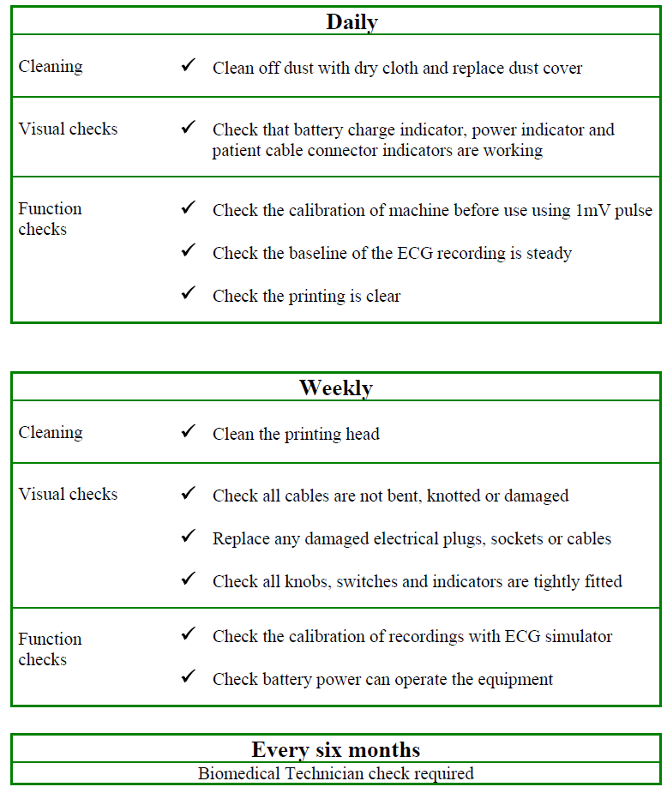
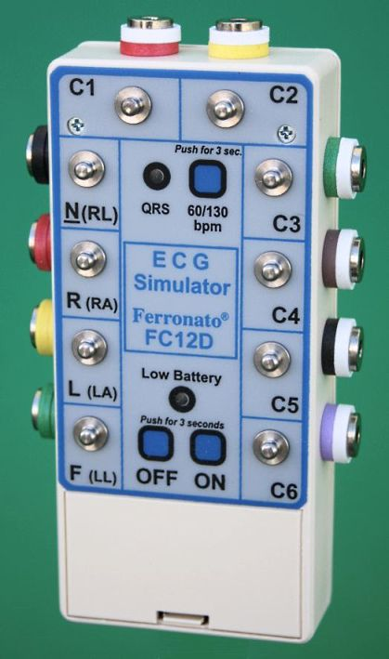
Preventive Maintenance
It is a good practice to clean the electrodes before release back to the floor. Also, check for any loose or broken lead wires. If the machine has a battery, check that it is in good condition and that the charger is working properly.
©
ECG Recorder and Monitor
dr. Chris R. Mol, BME, NORTEC, 2017

Slide 22

END
The creation of this presentation was supported by a grant from THET:
see https://www.thet.org/

